Slide 1
Group 1-A
Team members
Keertiraj Malik
Abhishek G Hegade
Anirudha Beedikar
Narendra S Kapashi

Slide 2
Artistic Image style Transfer

Slide 3
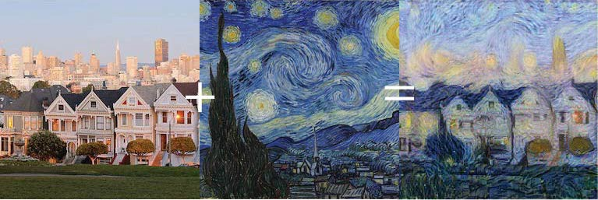
objective
Given a piece of art and a photo of a person we will be able to convert the style of the photo into that of the art .

Slide 4
Developing WebApp using Flask
Flask is a micro web framework written in Python
It makes the process of designing a web application simpler.
Flask will receive requests. It will figure out what those requests are dealing with and what they are asking. It will also figure out what response to send to the user.
Flask lets us focus on what the users are requesting and what sort of response to give back.

Slide 5
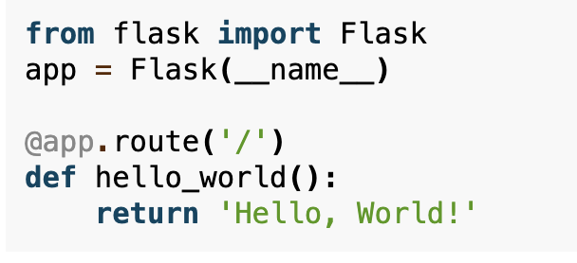
Basic Flask structure

Slide 6
How to create Web App using Flask
First we imported the Flask class.
Next we create an instance of this class.
We then use the route() decorator to tell Flask what URL should trigger our function.
The function is given a name which is also used to generate URLs for that particular function and returns the message we want to display in the user’s browser.

Slide 7
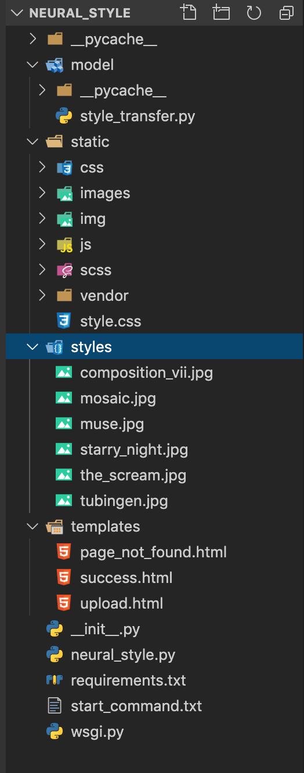
Implementation
Model
Code for image style transfer
Static
CSS and JS file related to HTML
Styles
Recommended pictures for style transfer
Templates
HTML files for UI
Init.py
base setup for the flask app
Neural_style.py
Base page for the flask app
Wsgi.py
Code related to the Python Web Server Gateway Interface HTTP server.

Slide 8
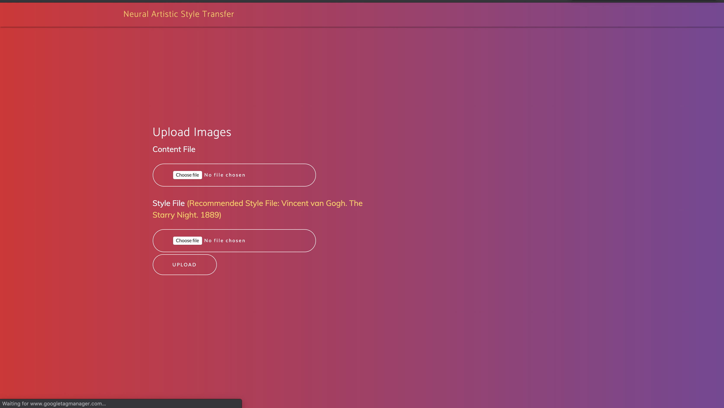
Front End UI snapshot

Slide 9
Deploying the Web Application
To show others the project we made, we will need to deploy it by using Cloud Services.
To deploy our web application to the cloud, we will use Platform as a Service (PaaS).
Ex : Heroku, Google App Engine, AWS Elastic Beanstalk, Azure (IIS),PythonAnywhere

